Slide 1


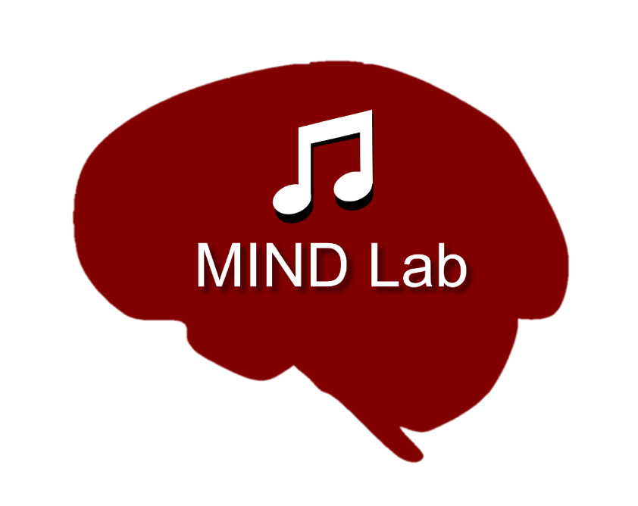
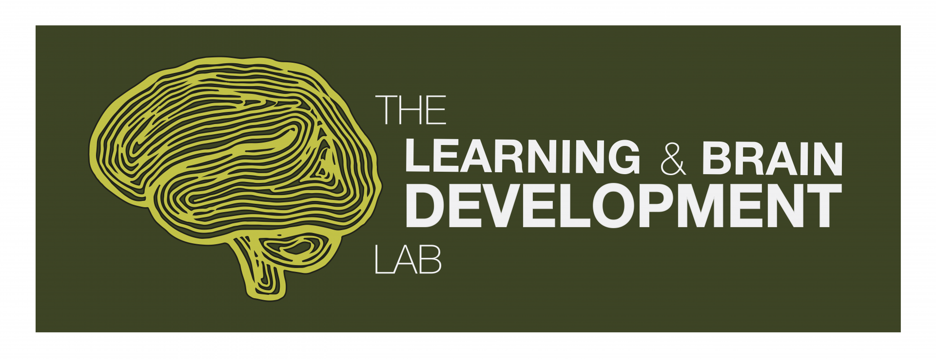
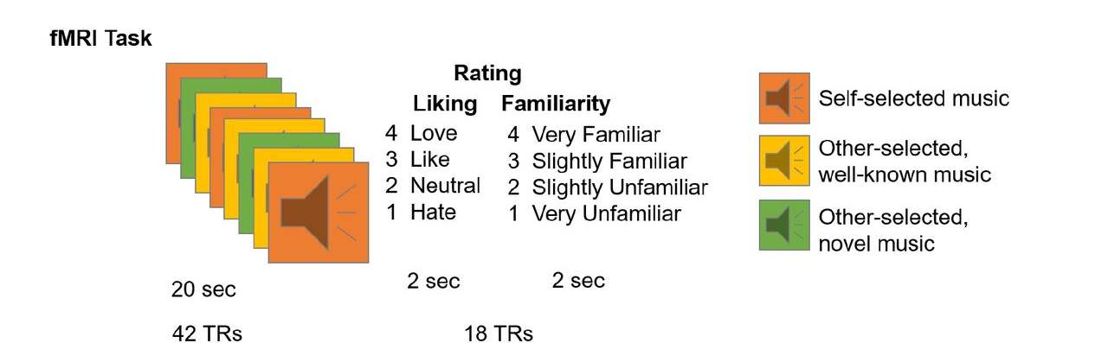
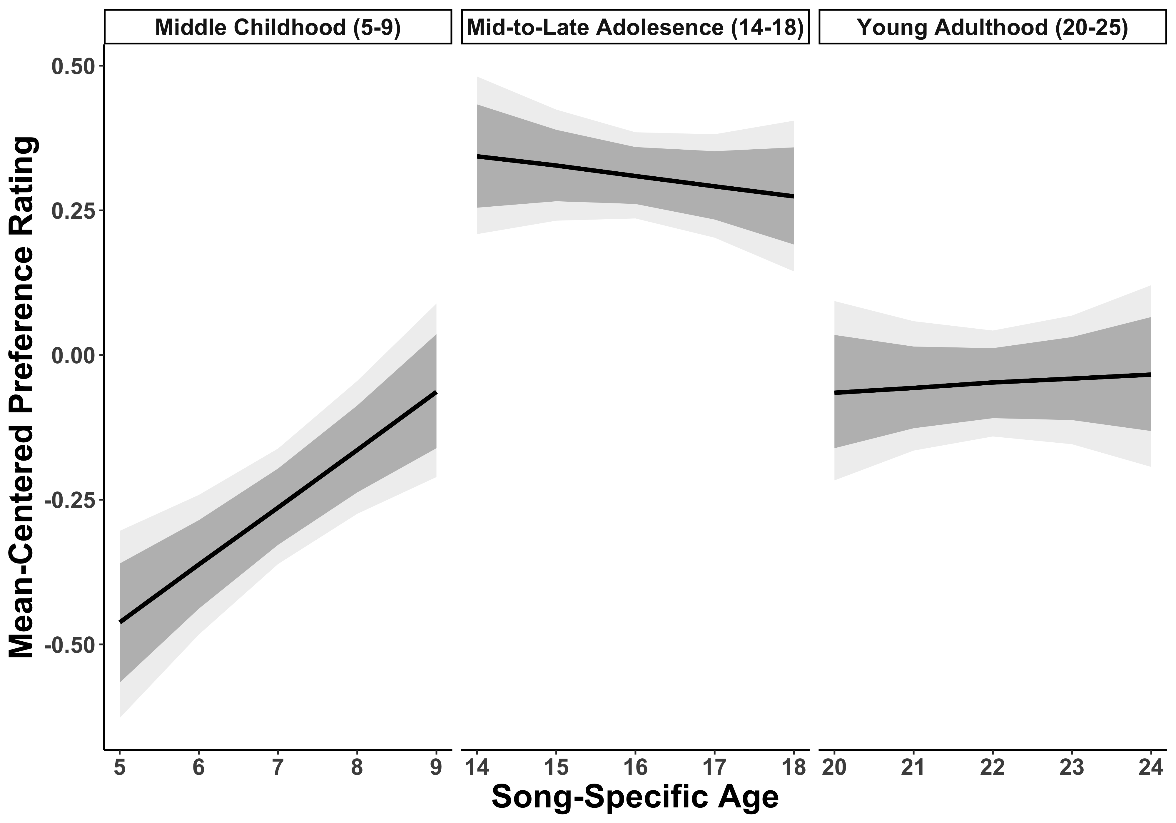
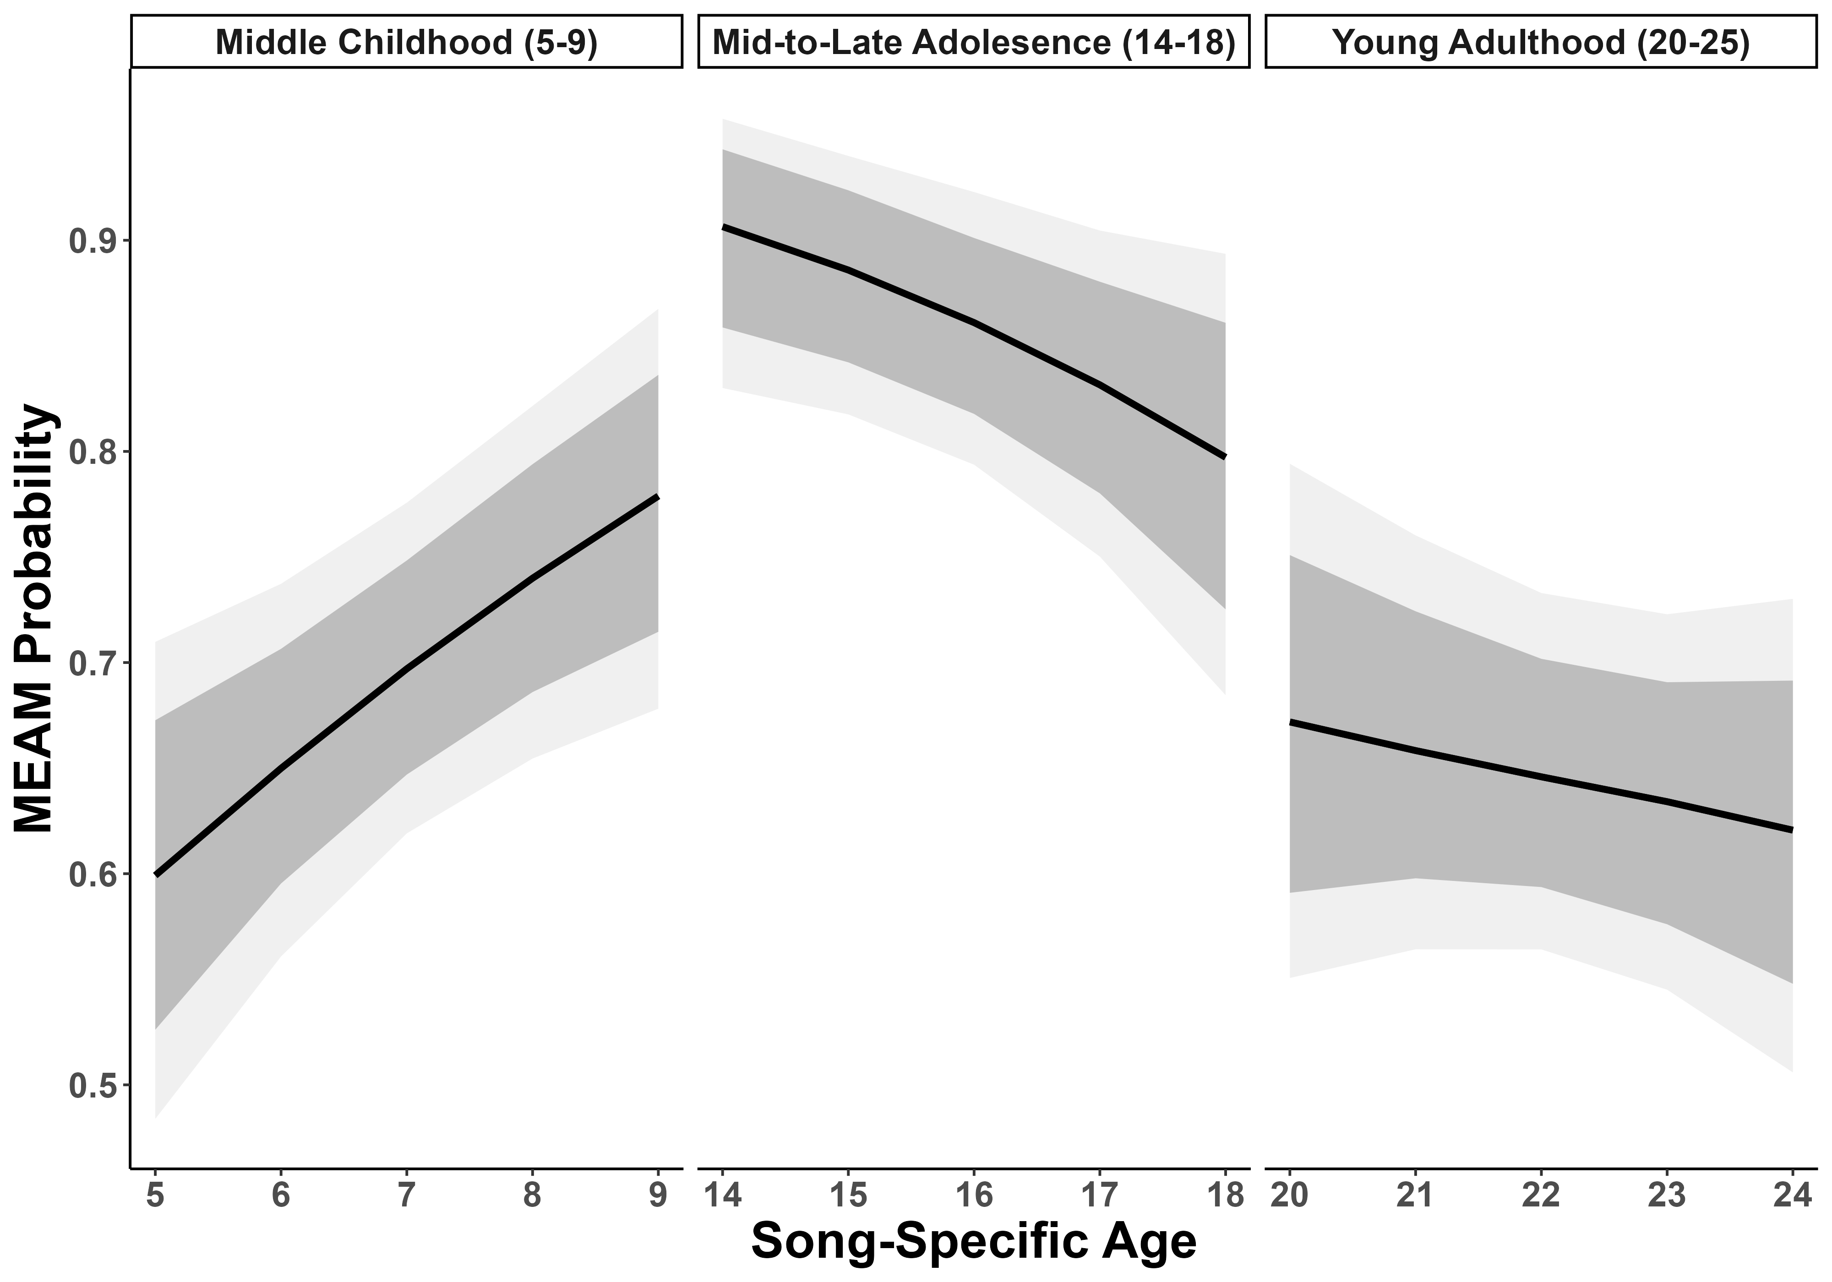

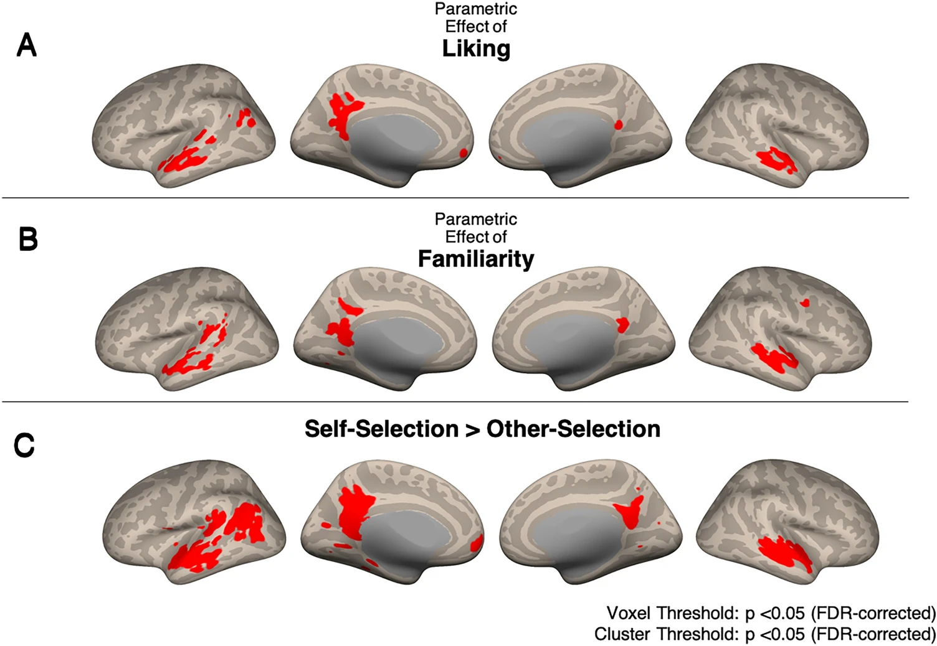
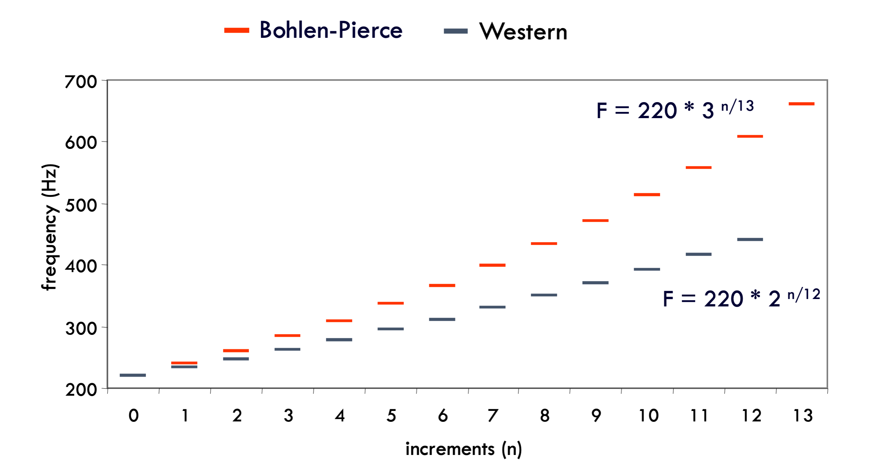
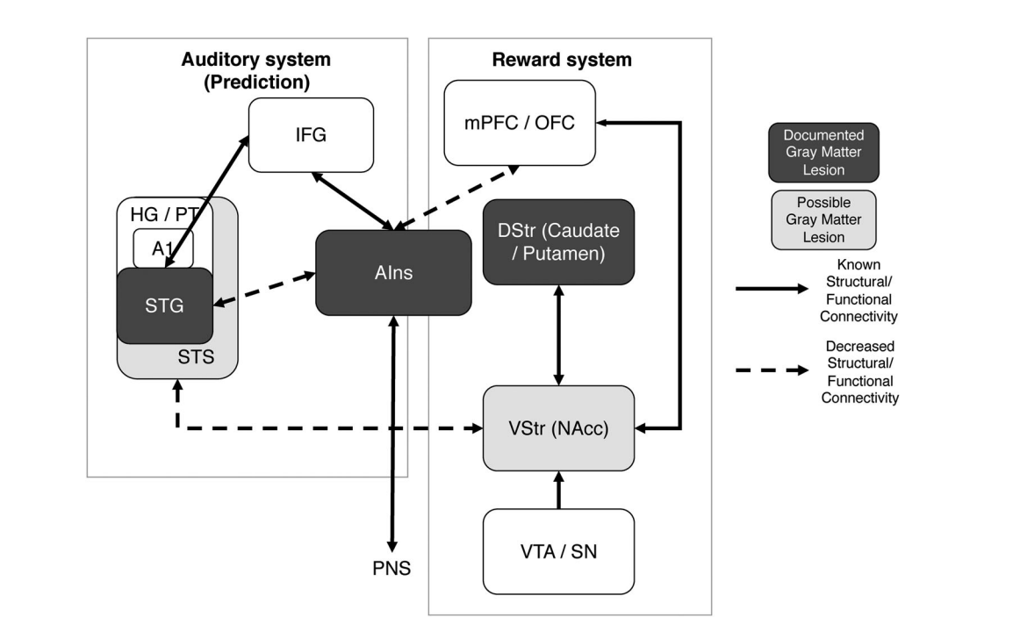
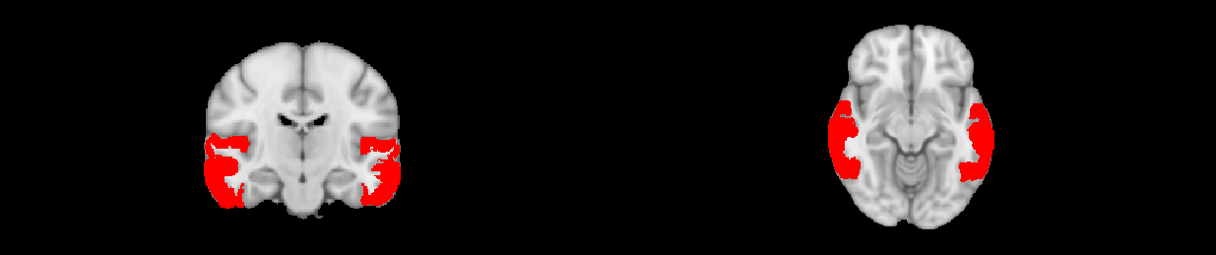
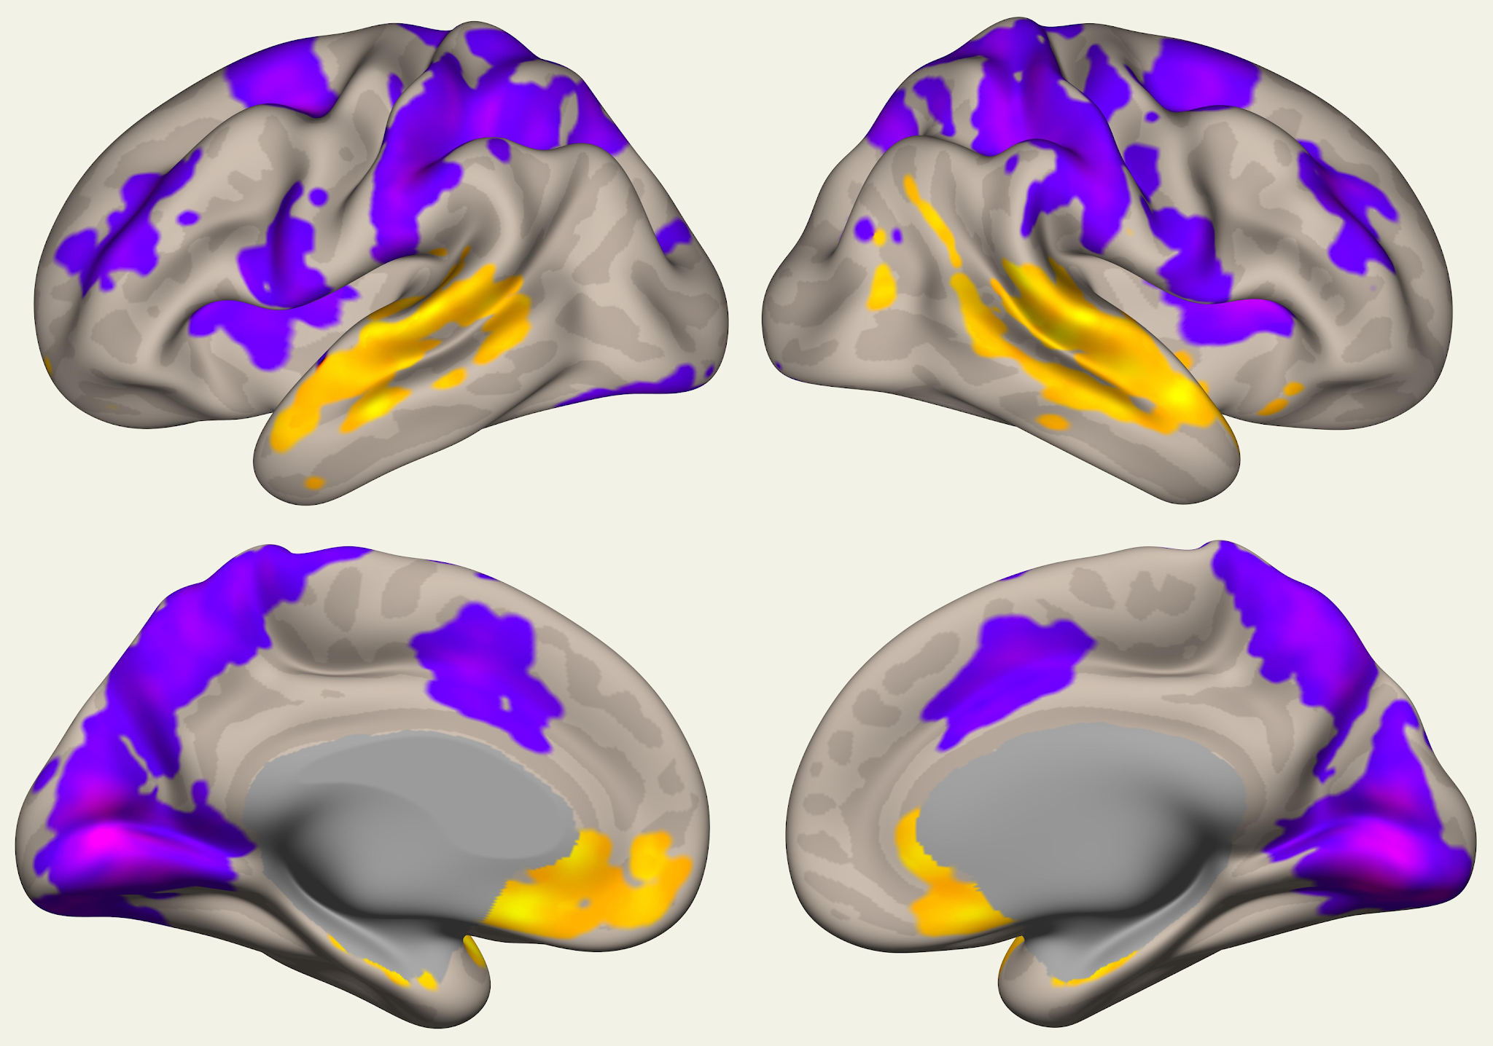
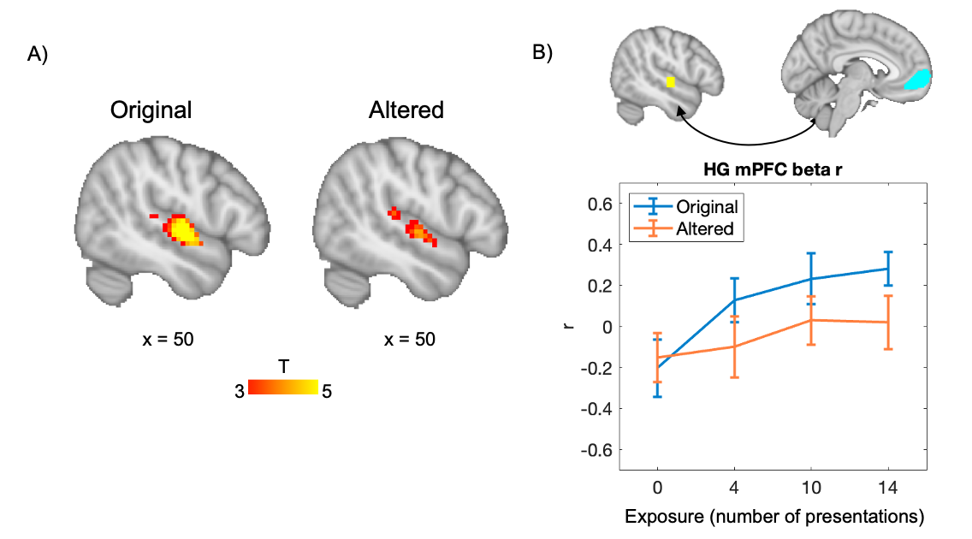
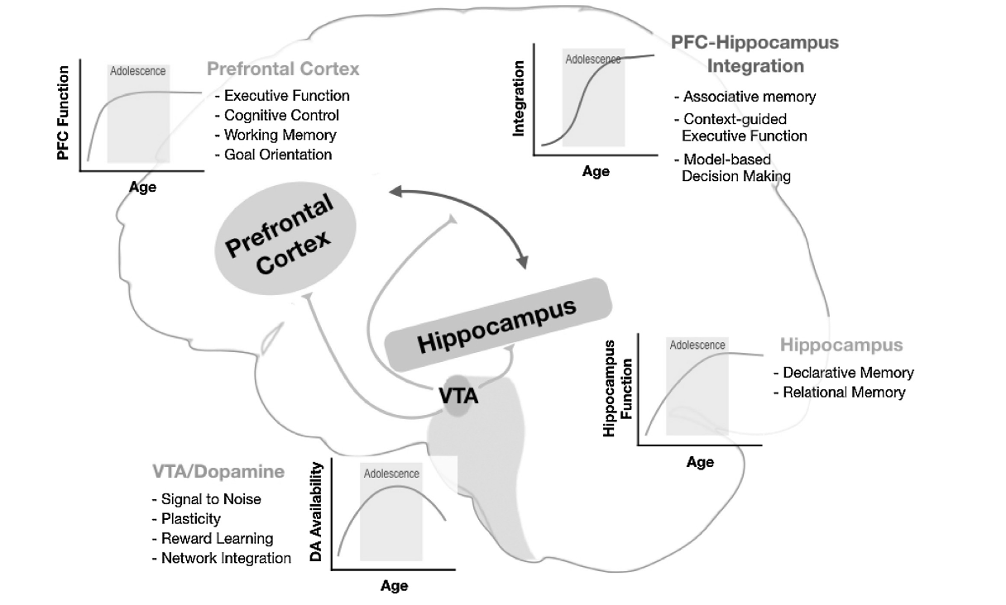
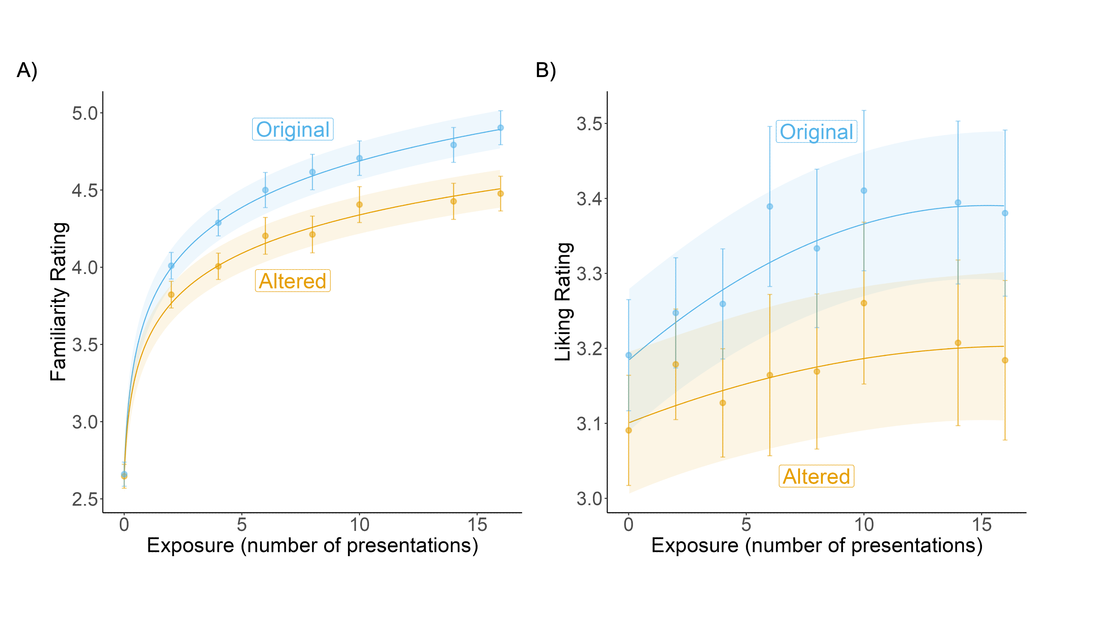




Leveraging novel music to examine age-related reward
responses across development
Nicholas Kathios, Kelsie L. Lopez, Juliet Y. Davidow, Laurel Gabard-Durnam, Psyche Loui
Northeastern University, Boston, MA
Introduction
Study Aims
Music Listening fMRI Task
Listening to music is regarded as one of the most pleasurable experiences across the lifespan¹
Older adults (ages 55+) show lifelong preference for music from adolescence, which also elicits the most spontaneous music-evoked autobiographical memories (MEAMs) in this population (the “reminiscence bump” effect²):
Music accrues implicit reward value by exploiting reward-prediction mechanisms: listeners tend to prefer music with predictable acoustic and structural features³
Pleasurable music listening experiences involve interactions between auditory and reward neural systems⁴
Adolescents show heightened sensitivity to reward-predictive cues and rewarding outcomes⁵, attributed to peak levels of dopamine signaling and reward system responsivity during this time⁶
Corticostriatal functional connectivity also shows positive age-related changes during adolescence⁷
Using a novel behavioral⁹ and music-listening¹⁰ paradigm developed in our lab, we propose to test the relationship between participants’ liking and familiarity of novel melodies with variable frequencies in a cross-sectional cohort of individuals ages 5-24
Aim 1: To characterize differences in behavioral reward responses (i.e. liking ratings) to music across children, adolescents, and young adults.
Aim 2: To compare functional connectivity during music listening across children, adolescents, and young adults, using fMRI
Studying how predictions relate to learning and reward is often challenging because most music that we encounter makes use of musical patterns listeners have been exposed to throughout their lives¹¹
To overcome this issue, music stimuli used in this task will be written in the Bohlen-Pierce scale, a musical system acoustically different from any existing scales across cultures¹²
Developmental Hypothesis: The age-related trajectory of the fit between number of presentations and liking ratings will be best characterized by an inverse-U curve, peaking in adolescence. In contrast, there should be no age-related differences in the strength of the relationship between familiarity and number of presentations.
Power analyses from adult data indicate that a sample size of N=68 will have 80% power in detecting an effect of number of presentations on subsequent liking ratings. To account for attrition rates in developmental studies, we will recruit 78 participants to meet this sample size.
BP Melodies from
Behavioral Task
Behavioral Task
Liked music engages auditory areas & mPFC
Music Year of Release – Participant Year of Birth
Music Year of Release – Participant Year of Birth
N = 16; ages 55-90
Voxel Threshold: p < 0.05 (FDR-corrected)
Cluster Threshold: p < 0.05 (FDR-corrected)
Figure from (10)
Auditory network & mPFC more functionally connected for younger compared to older adults during music listening
Phase 1
(pre-ratings)
Phase 2
(exposure)
Phase 3
(testing in scanner)
Auditory Network Seed
YA (N = 24; age_{mean} = 18.6) > OA (N = 24; age_{mean} = 66.7)
Figure from (13)
Liking?
Familiarity?
Listen
(x2,x4,x8,x16)
Liking?
Familiarity?
Auditory cortex sensitive to PE; FC with mPFC tracks with both exposure & PE
Liking & familiarity ratings sensitive to both exposure & PE
Developmental Hypothesis: Fronto-striatal connectivity will peak in adolescence while listening to both self-selected music and the Bohlen-Pierce melodies presented more often during the behavioral task.
Figure from (9)
N = 665; ages 18-65
Figure from (8)
Figure from (9)
Research Questions:
Does heightened reward sensitivity in adolescence contribute to an increase in music reward valuation during adolescence?
How does developmental maturation of the reward system—particularly that which is involved in rewarding music-listening experiences—relate to changes in music reward valuation in adolescence?
Can age-related changes in music reward valuation across development explain lifelong increases in preference and memory associations for music from adolescence?
Discussion
Music provides a powerful, yet relatively underutilized, perspective into the neurocognitive developmental trajectory of reward responses
As reward value modulates the strength of MEAM encoding (15), this effort offers insight into potential developmental processes that give rise to the reminiscence bump
Music-based interventions may be particularly effective in developmental populations that experience heightened musical reward
References & Acknowledgments
Dube, L., & Le Bel, J. (2003). The content and structure of laypeople’s concept of pleasure. Cogn Emot, 17(2), 263–295. https://doi.org/10.1080/02699930302295
Kathios, N., Bloom, P. A., Singh, A., Bartlett, E., Algharazi, S., Siegelman, M., Shen, F., Beresford, L., DiMaggio-Potter, M., Bennett, S., Natarajan, N., Ou, Y., Loui, P., Aly, M., & Tottenham, N. (2023). Spontaneous music-evoked memories in cognitively healthy older adults: Associations between emotion, familiarity, and memory across familiar and unfamiliar music. PsyArXiv. https://doi.org/10.31234/osf.io/dpj6g
Gold, B. P., Mas-Herrero, E., Zeighami, Y., Benovoy, M., Dagher, A., & Zatorre, R. J. (2019). Musical reward prediction errors engage the nucleus accumbens and motivate learning. Proc. Natl. Acad. Sci. U. S. A., 116(8), 3310–3315. https://doi.org/10.1073/pnas.1809855116
Belfi, A. M., & Loui, P. (2020). Musical anhedonia and rewards of music listening: Current advances and a proposed model. Annals of the New York Academy of Sciences, 1464(1), 99–114. https://doi.org/10.1111/nyas.14241
Spear, L. P. (2000). The adolescent brain and age-related behavioral manifestations. Neuroscience & Biobehavioral Reviews, 24(4), 417–463. https://doi.org/10.1016/S0149-7634(00)00014-2
Padmanabhan, A., & Luna, B. (2014). Developmental imaging genetics: Linking dopamine function to adolescent behavior. Brain and Cognition, 89, 27–38. https://doi.org/10.1016/j.bandc.2013.09.011
Davidow, J. Y., Insel, C., & Somerville, L. H. (2018). Adolescent Development of Value-Guided Goal Pursuit. Trends in Cognitive Sciences, 22(8), 725–736. https://doi.org/10.1016/j.tics.2018.05.003
Murty, V. P., Calabro, F., & Luna, B. (2016). The role of experience in adolescent cognitive development: Integration of executive, memory, and mesolimbic systems. Neuroscience & Biobehavioral Reviews, 70, 46–58. https://doi.org/10.1016/j.neubiorev.2016.07.034
9. Kathios, N., Sachs, M. E., Zhang, E., Ou, Y., & Loui, P. (2023). Generating New Musical Preferences from Multi-level Mapping of Predictions to Reward (p. 2022.06.17.496615). bioRxiv. https://doi.org/10.1101/2022.06.17.496615
10. Quinci, M. A., Belden, A., Goutama, V., Gong, D., Hanser, S., Donovan, N. J., Geddes, M., & Loui, P. (2022). Longitudinal changes in auditory and reward systems following receptive music-based intervention in older adults. Scientific Reports, 12(1), 11517. https://doi.org/10.1038/s41598-022-15687-5
11. Hannon, E. E., & Trehub, S. E. (2005). Metrical Categories in Infancy and Adulthood. Psychological Science, 16(1), 48–55. https://doi.org/10.1111/j.0956-7976.2005.00779.x
12. Loui, P., Wessel, D. L., & Kam, C. L. H. (2010). Humans Rapidly Learn Grammatical Structure in a New Musical Scale. Music Perception: An Interdisciplinary Journal, 27(5), 377–388. https://doi.org/10.1525/mp.2010.27.5.377
13. Belden, A., Quinci, M. A., Geddes, M., Donovan, N. J., Hanser, S. B., & Loui, P. (2023). Functional Organization of Auditory and Reward Systems in Aging. Journal of Cognitive Neuroscience, 1–23. https://doi.org/10.1162/jocn_a_02028
14. Ferreri, L., Mas-Herrero, E., Cardona, G., Zatorre, R. J., Antonijoan, R. M., Valle, M., Riba, J., Ripollés, P., & Rodriguez-Fornells, A. (2021). Dopamine modulations of reward-driven music memory consolidation. Annals of the New York Academy of Sciences, 1502(1), 85–98. https://doi.org/10.1111/nyas.14656
We acknowledge support from NSF-GRFP awarded to NK and seed grant funding from Northeastern University’s Center for Cognitive and Brain Health awarded to PL, JYD, and LGD.
Listen to Bohlen-Pierce melodies at this OSF Repository:
kathios.n@northeastern.edu
@nickkathios

